Slide 1
Idea!
To show the Danish people what a smoke sauna is – or could be!
The trial was carried out during the ”Sauna-Event 2015 on January 17th on a cold and very windy day.
As the Sauna-Event 2015 was about portable saunas, the smoke sauna was chosen to be in a 9 x 3 m. party tent.
(Unfortunately delivered without both gables!)

Slide 2
How to create a portable smoke sauna:
Borrow 1,5 tons of granite stones.
Find a hot air balloon skipper.
Find a big party tent.
Get it heated up without tent fire.
Create the smoke feeling.

Slide 3
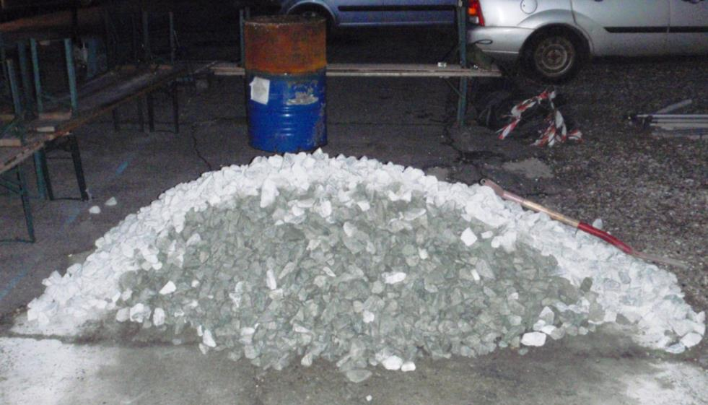
The 1,5 tons of stones
Was borrowed from a nearby stone & gravel co.
against the transport costs: 333 €

Slide 4
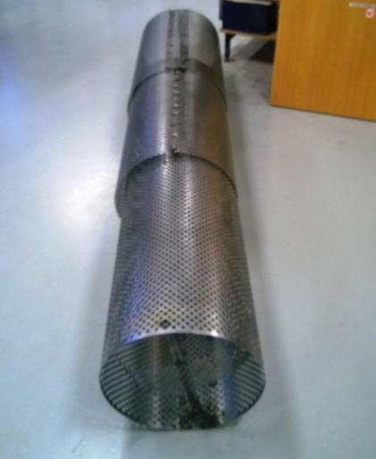
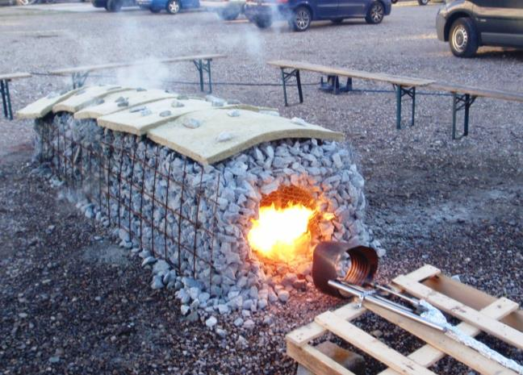
Heating up:
Telescopic burning chamber
(0,90-2,40 m. = easy transport)
Heat source
A hot air
Balloon
Burner!

Slide 5
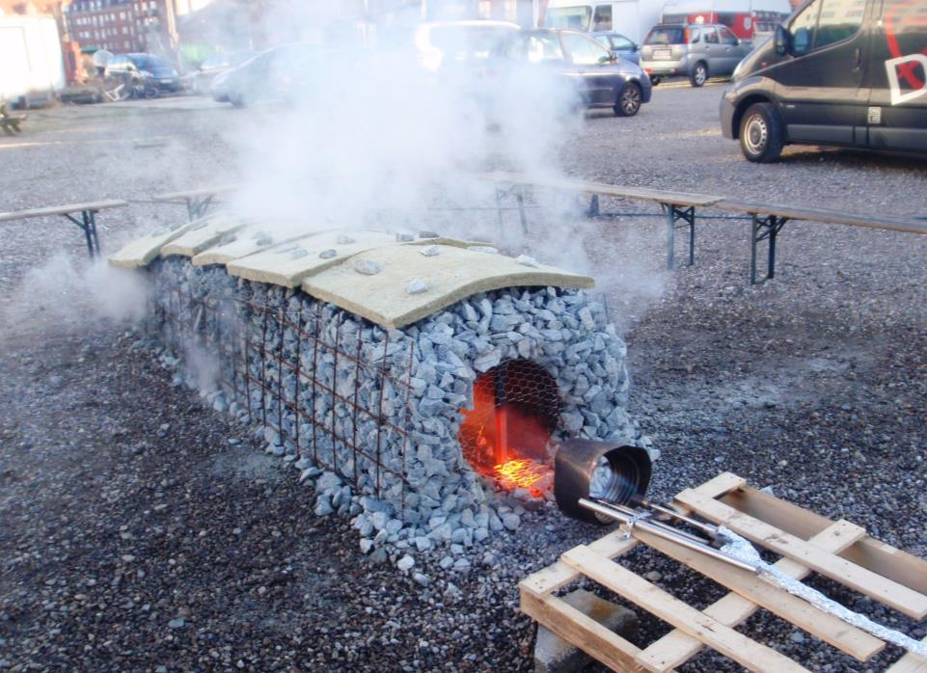
Smoke?
Just by putting
firewood into the
burning chamber!

Slide 6
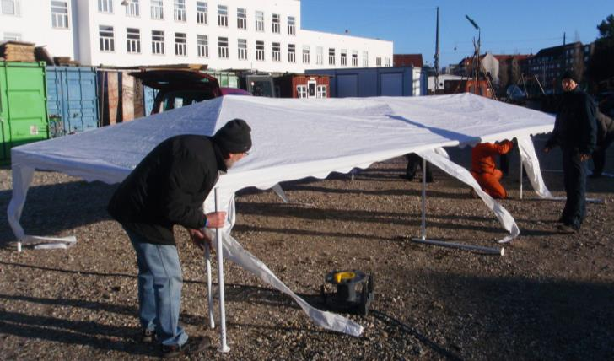
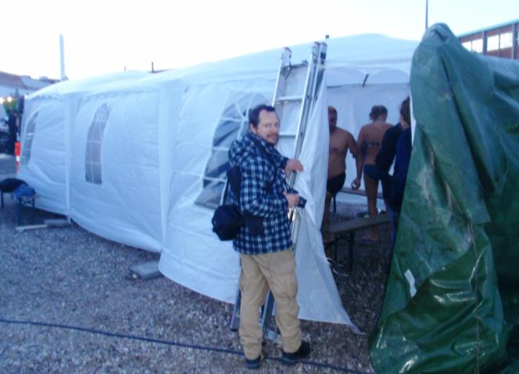
Building the tent!
In stormy weather!
And with fast invented gables!

Slide 7
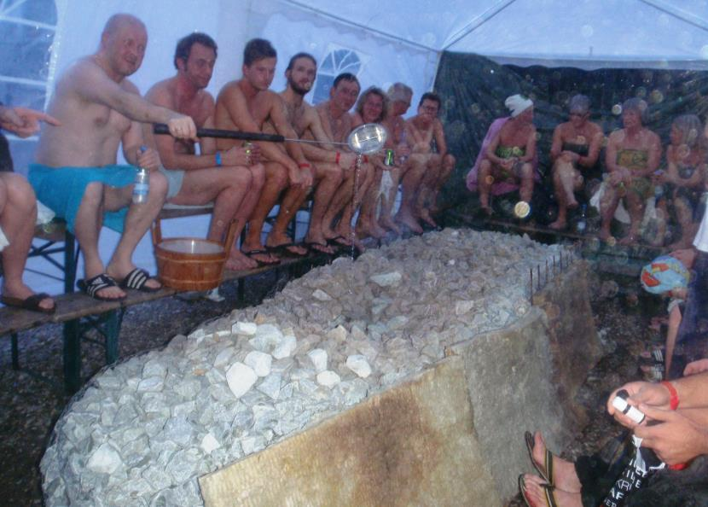
The final result:
Due to too eagerly heating the roof softened and the burning chamber melted partly! But apart from that, people and the press got a good impression! And we learned a lot from our mistakes!!
By the way:
It is Tito Gronow
from the Finnish
Embassy and
member of SSS
who is ”Löylymajuuri”!

Slide 8
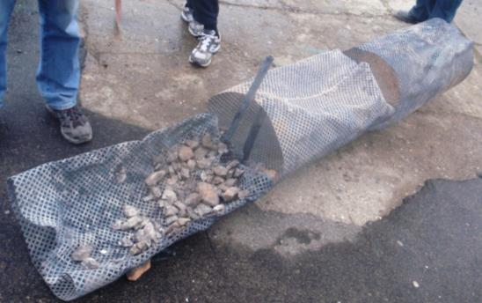
Statistics:
You smoke sauna lovers know, that there is only one disadvantage of smoke saunas:
It takes very long time, to heat it up and clean it afterwards!
Our solution:
Use 40 liters of liquid gas and 25 liters of birch firewood, and it is done in less than one hour! ;o)
Max. Temperature in the stones was measured to 870º C. a little too much!

Slide 9
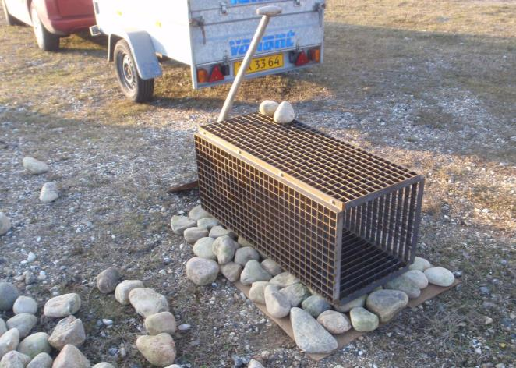
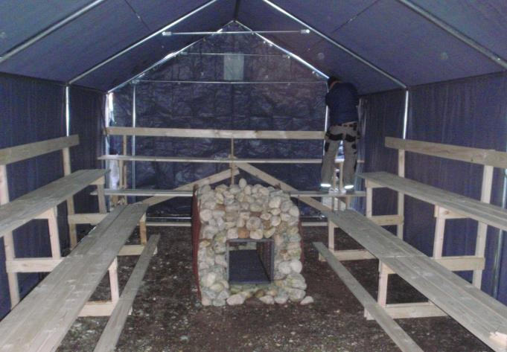
Development in 2016:
New improved burning chamber with smaller measures: 40 x 40 x 100 cm
And stronger walls!!
And a new solid tent!! (Weight: 250 kg.)

Slide 10
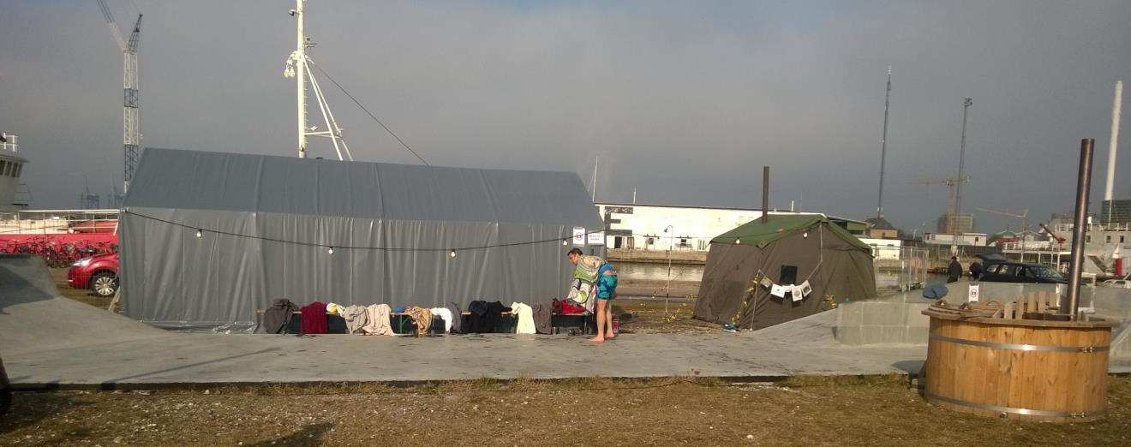
In action at the yearly sauna event in 2016
Notice the size compared to the Savotta tent sauna w. room for 6 persons!!

Slide 11
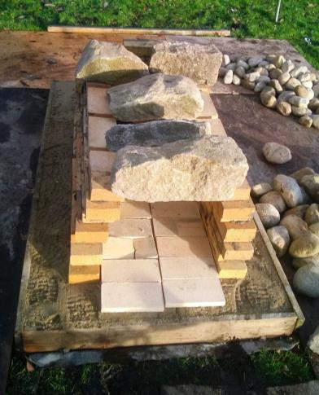
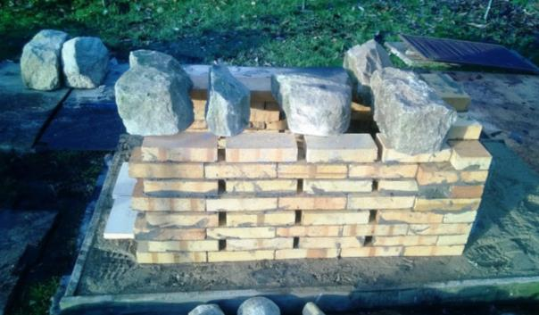
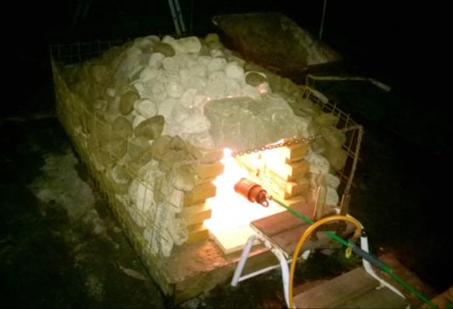
Further improvements in 2017:
A new stationary stove build up by heat resistant bricks and granite stones.
A lowered ceiling with shiny surface directing the heat away from the rooftop and down towards the benches.

Slide 12
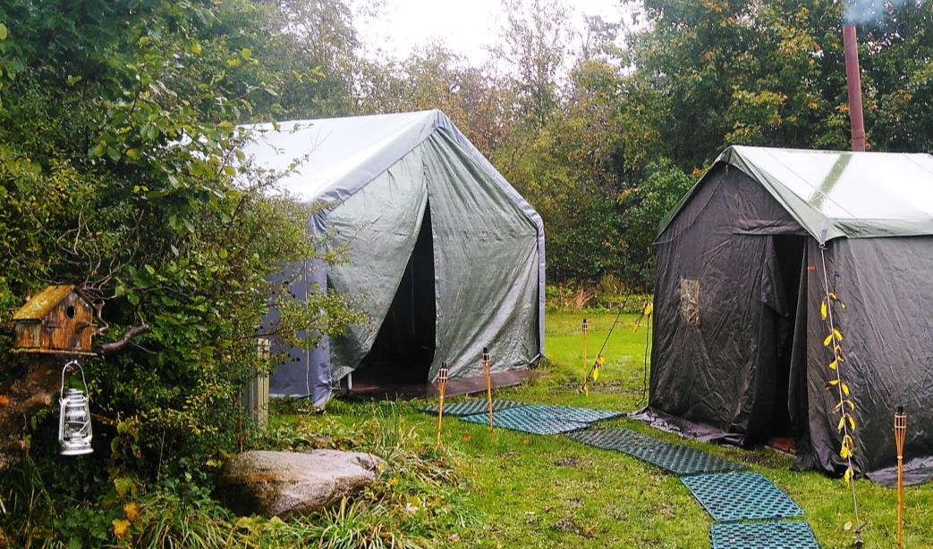
So it has now a stationary placement at the Danish Naturists Leisure centre 25 km from Copenhagen city centre. But can be moved anytime, as at the 2 saunaevents in Cph. And Aarhus celebrating Finlands 100 year anniversary!

